Slide 1

Natural Language Processing Course Reading Text Data into Python
Ivo Bernardo – Udemy Course

Slide 2


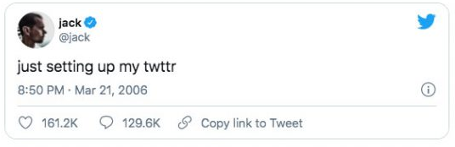
Reading Text Data Into Python - CSV Files
-> Libraries used for reading csv files: Pandas or csv library

Slide 3


Reading Text Data Into Python – TXT Files

Slide 4
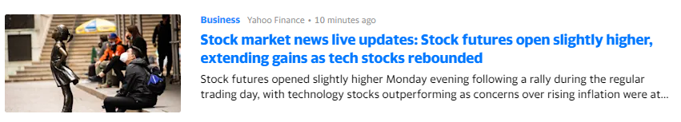
Reading Text Data Into Python – Web Pages
-> Libraries used for web scraping: Requests and BeautifulSoup

Slide 5
Reading Text Data Into Python – Status Codes
-> 200: Ok
-> 400: Not Found
-> 401: Authentication Failed
-> 404: Error

Slide 6
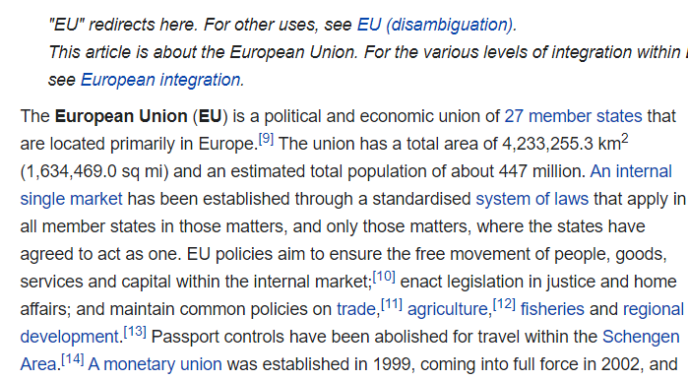
Reading Text Data Into Python – Web Pages
-> Libraries used for web scraping: wikipedia

